Slide 1
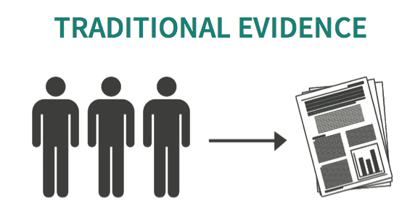
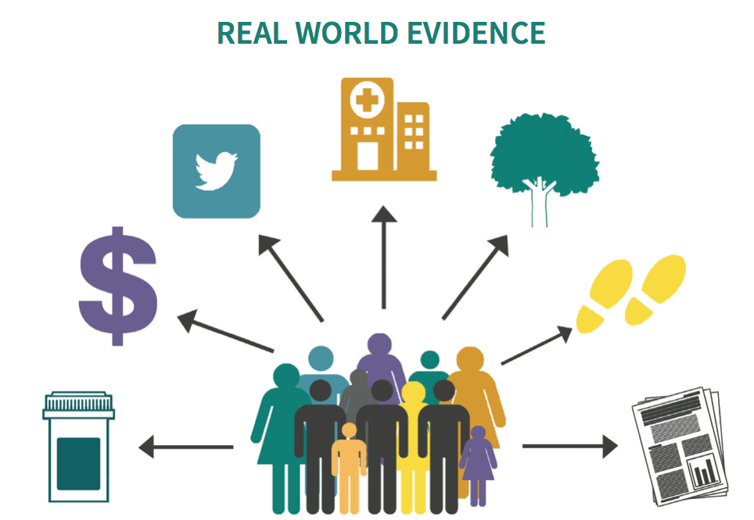
Traditional evidence, real world data, real world evidence
The network for excellence in health innovation. 2015
Giuseppe Aprile, Udine

